Slide 1
Civic Engagement
BY: Yash, Kanchan, Vedaang and Zayd

Slide 2
Where and How we volunteered?
We volunteered at the school library by helping the teachers and students. We sorted books in the library by classifying them to make it easy for the students to access and by shelving books on perfectly alphabetized shelves. We labelled different books with different categories by numbering them. Also, we helped some students by suggesting them what kind of book they would like as some couldn’t decide. When we were classifying the books, we were suppose to read the blurbs of each book to understand what kind of story that book has. This increased our knowledge of some stories and persuaded some of us to read further more.

Slide 3
My experience – Yash
My experience at the school library was very interesting and absorbing. While I was reading the blurbs, I started getting attached to the book. I started to find reading very refreshing. I had limited interest in reading books earlier as I would find it boring and time consuming, at times I used to lose interest in the middle of the story, but this experience helped me gain my interest in reading.
It also helped me improve my communication skills as I interacted with other students and discussed with them about their preferences in books, stories and authors. After this experience, I would like to continue reading more books which will help me improve my writing skills also as I would grasp more and learn different vocabulary.

Slide 4
My experience - Kanchan
At the library I learnt different writing styles and peoples opinions on various things. This experience also improved my communication skills.

Slide 5
My experience – Vedaang
Throughout the civil engagement project in the library I learnt various communication skills and discussed important issues of the world which collates with my option Global Perspective.

Slide 6
My experience - Zayd
My experience throughout the civil engagement project in the library was very helpful. I learnt various communication skills as I communicated with other students.

Slide 7
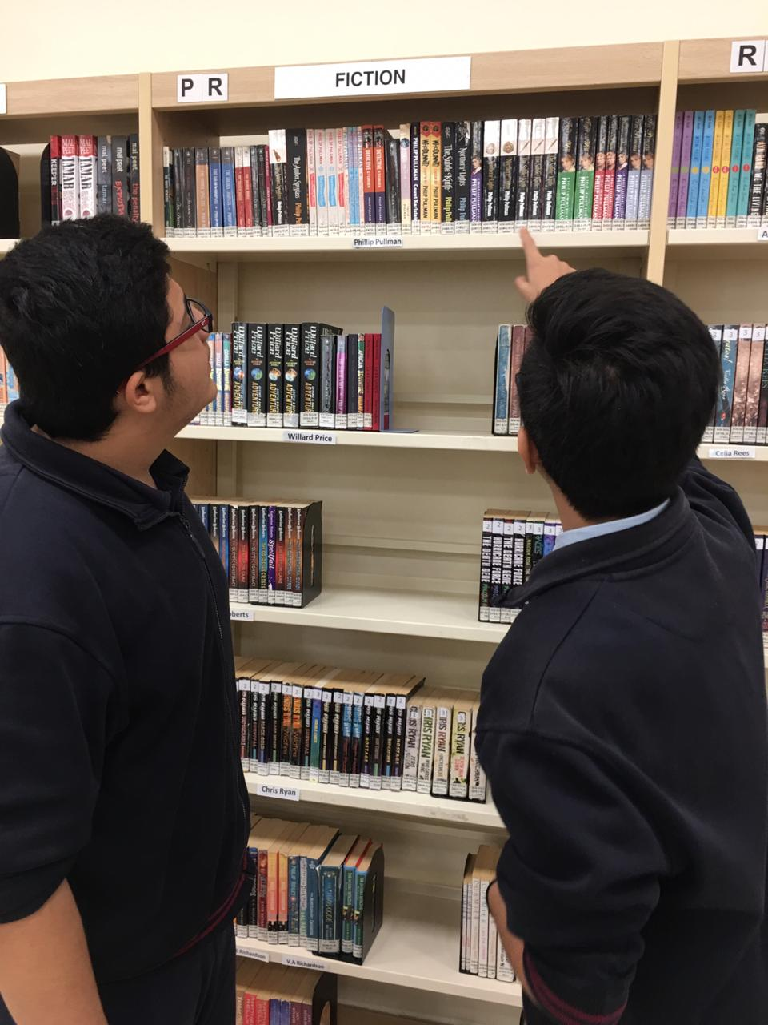
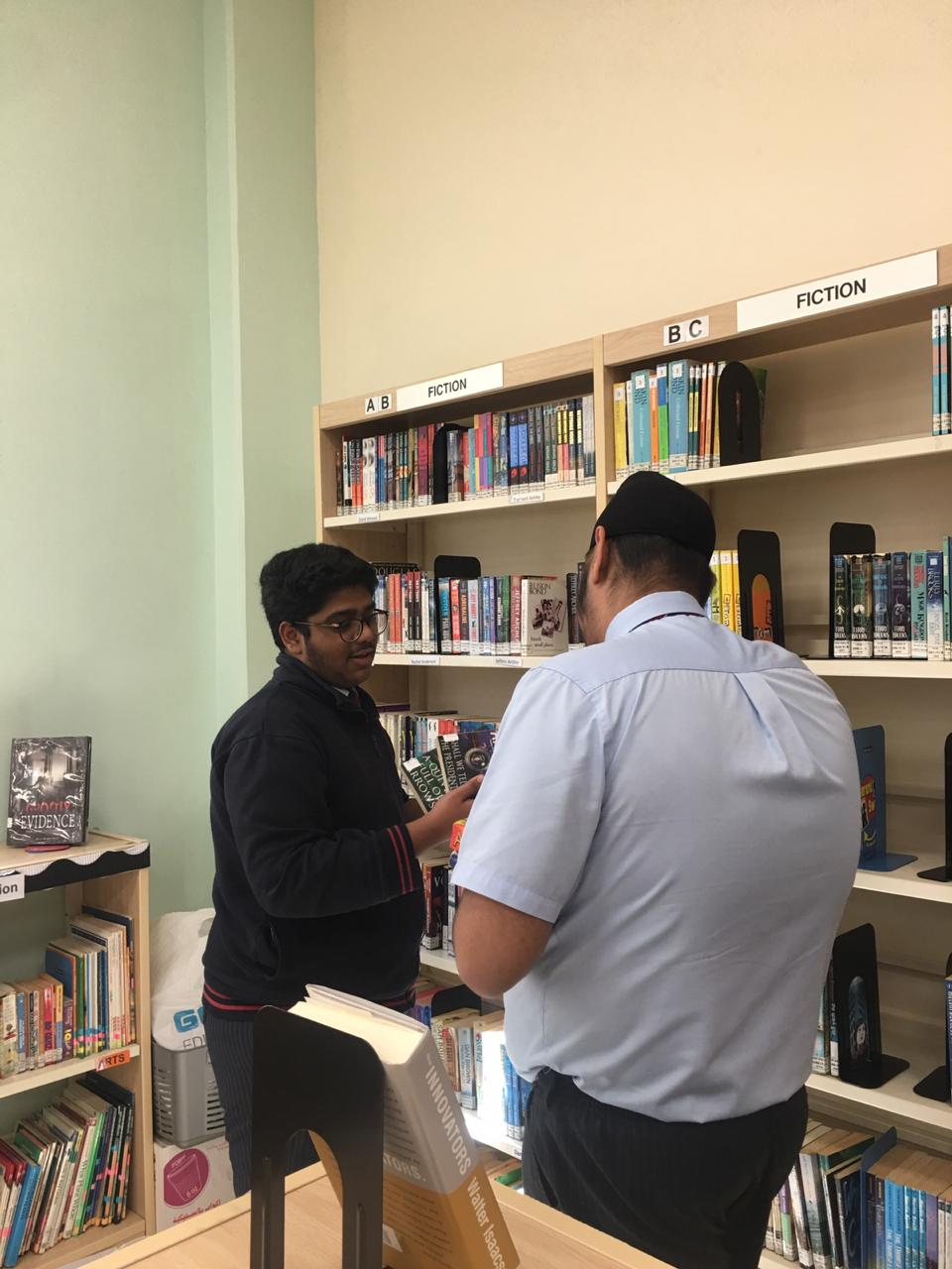
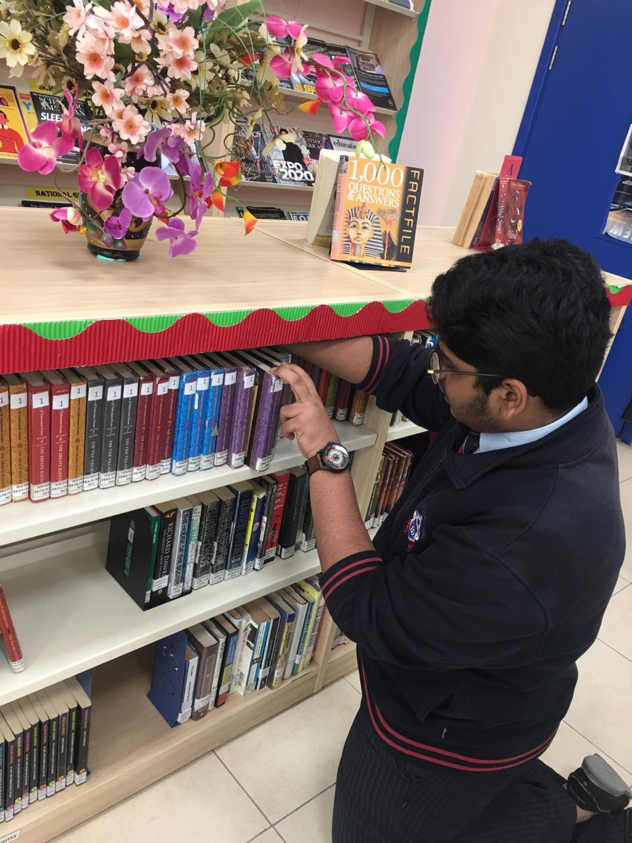
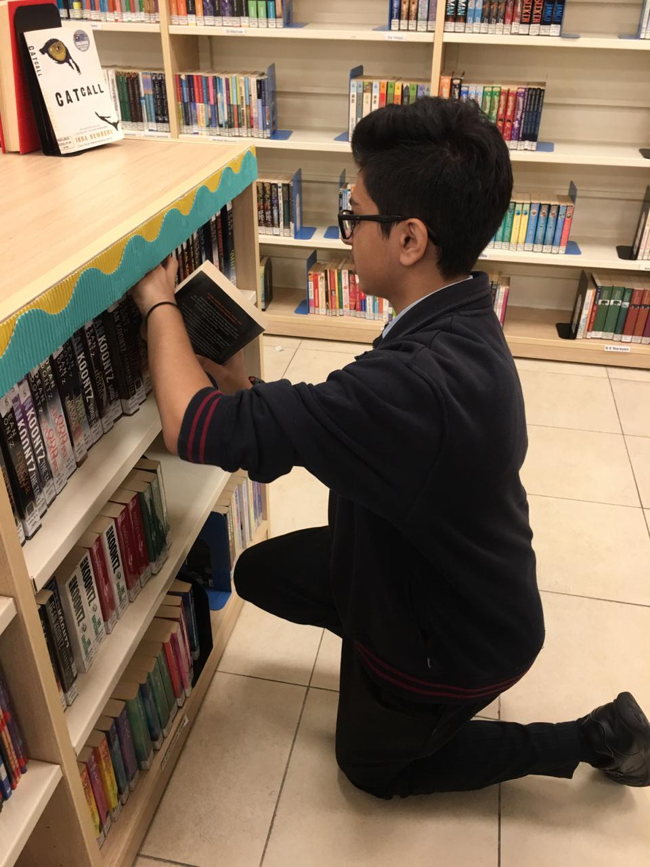
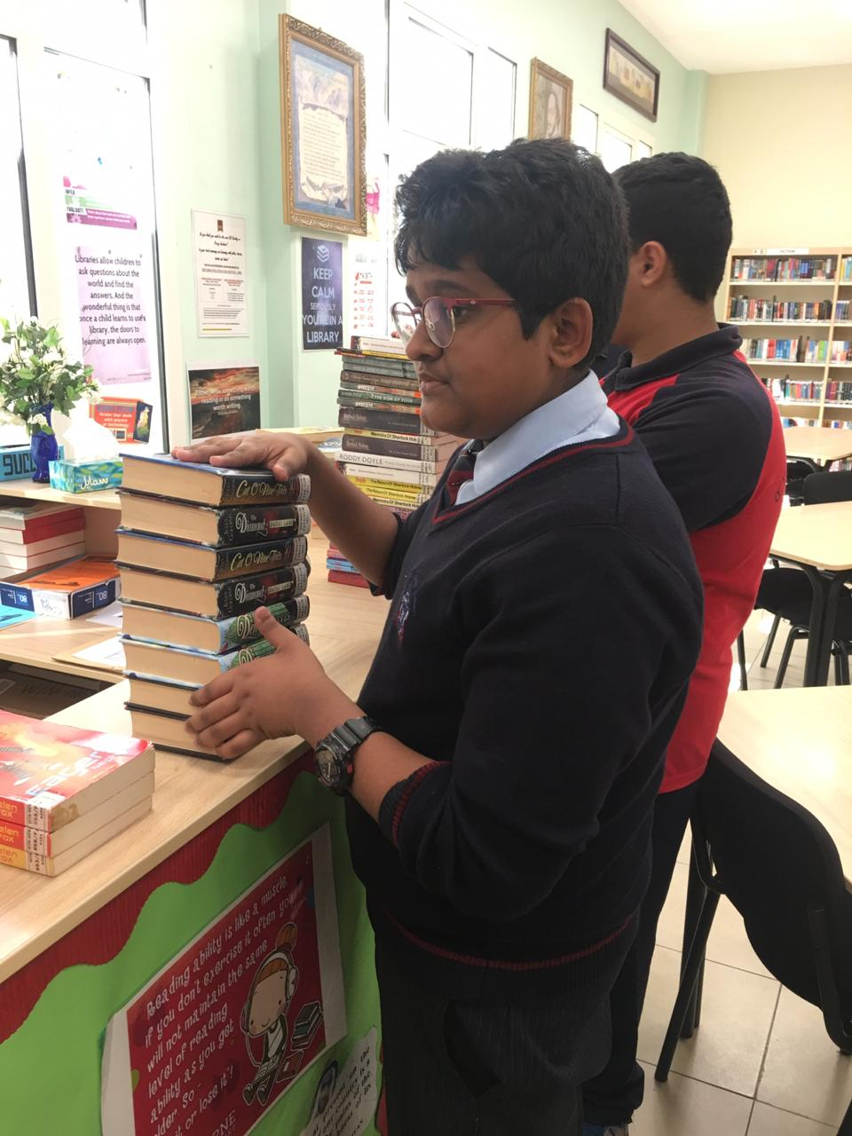
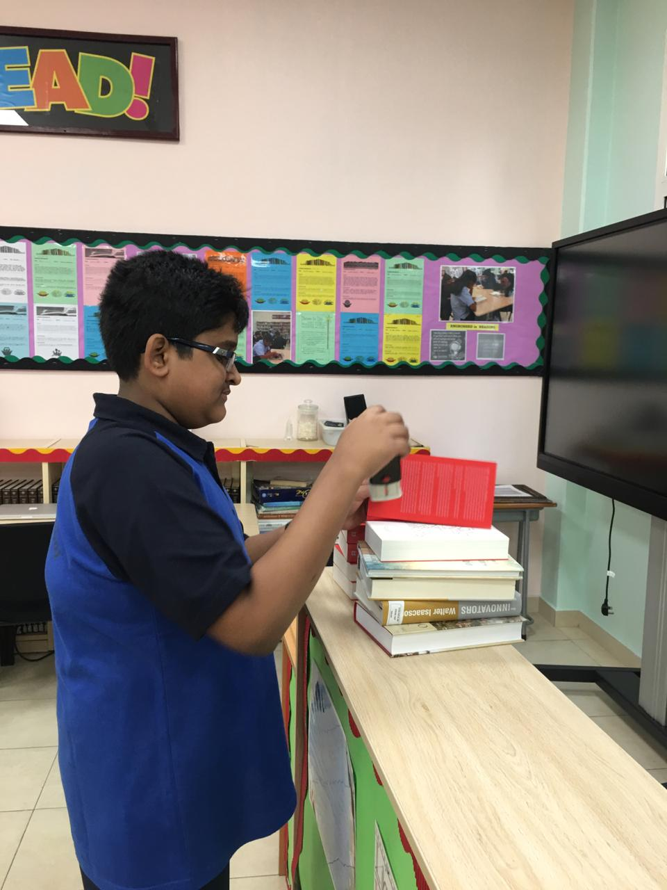
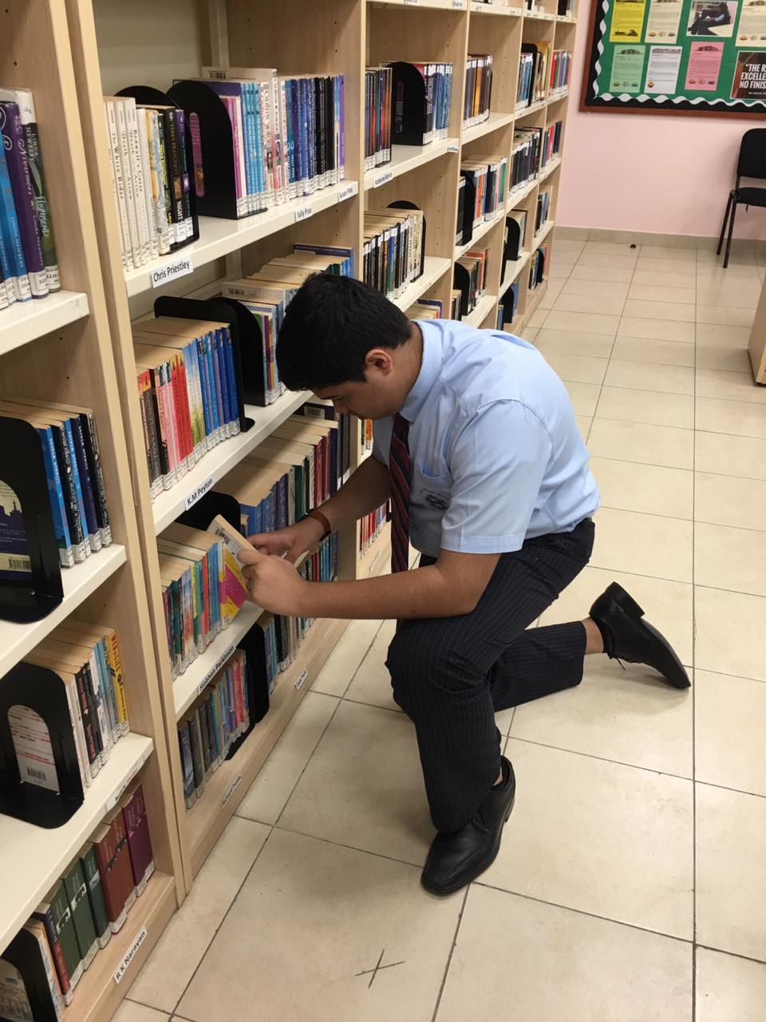
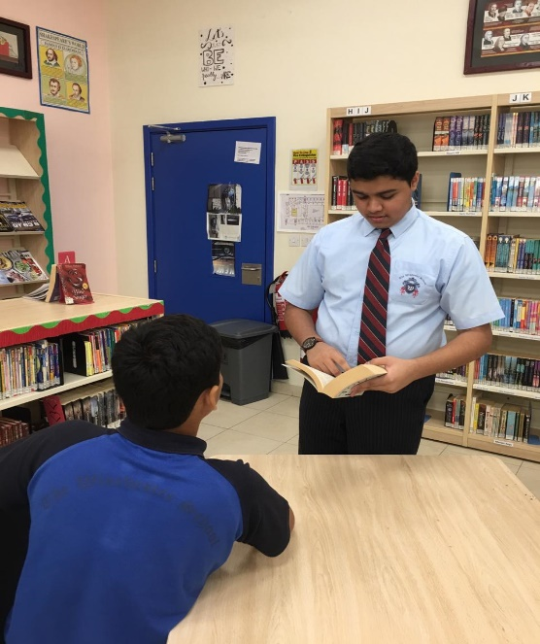

Slide 8
Thank you

