Slide 1
VISIT FRANCE
DONE BY: THARUN&WASAY
8-B

Slide 2
Family package
1 week and 4 days stay in France
4 star hotel
Tour guide
Prices
10,550-11,120 dhs (depending on which priority) including flight ,hotel ,food and tickets to destinations
Flight cost : 1,900 (economy), 2,450 (business class) for one person (kids under age 3 free)

Slide 3
Backpacker package
1 week and 1 day stay in france
Hostal (4 star)
Tour guide (if necessary)
Prices
4,550 dhs (depending on which priority) including flight,hotel,food&tickets to destinations
Flight cost : 1,900 (economy)

Slide 4
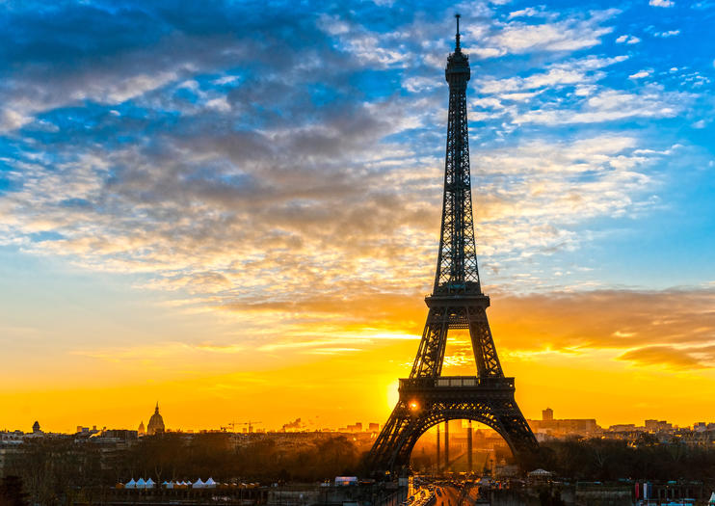
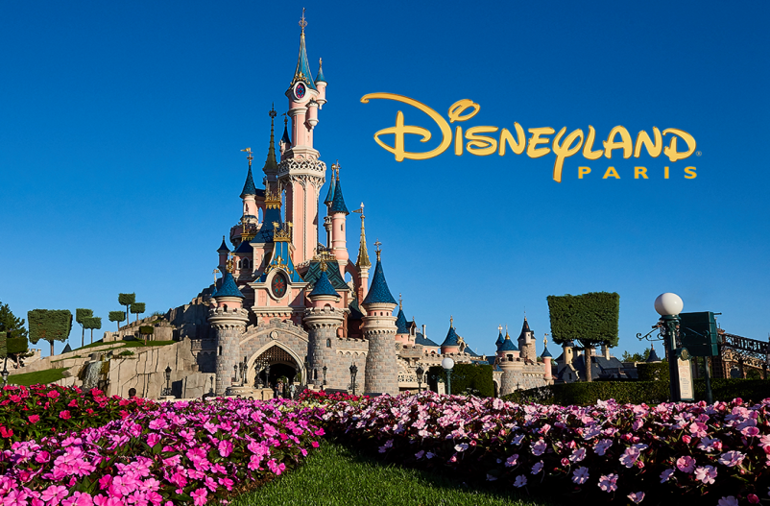
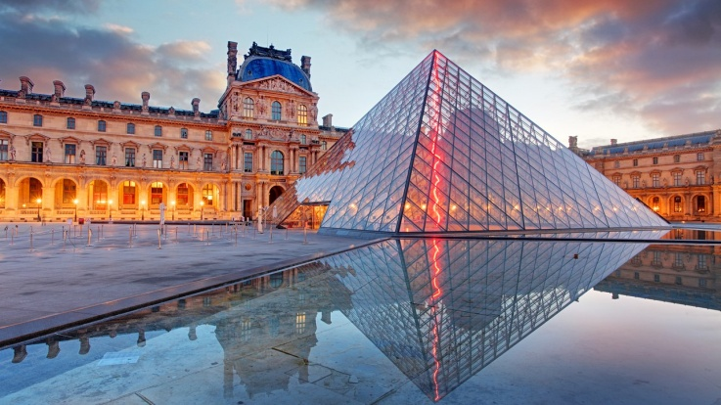
Places to visit for family
Eiffel tower
Louvre museum
Palace of Versailles
Disneyland Paris
Champs-Elysees
French Riviera

Slide 5
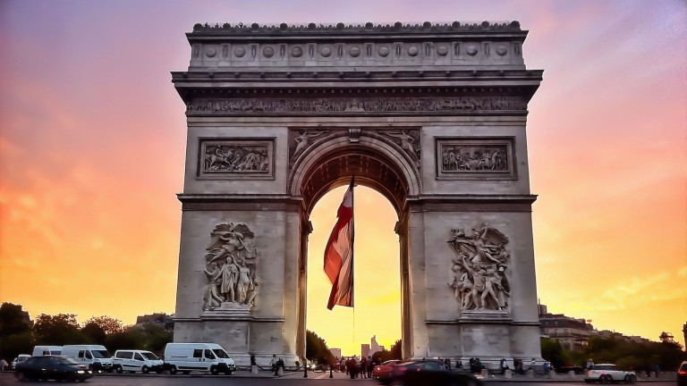
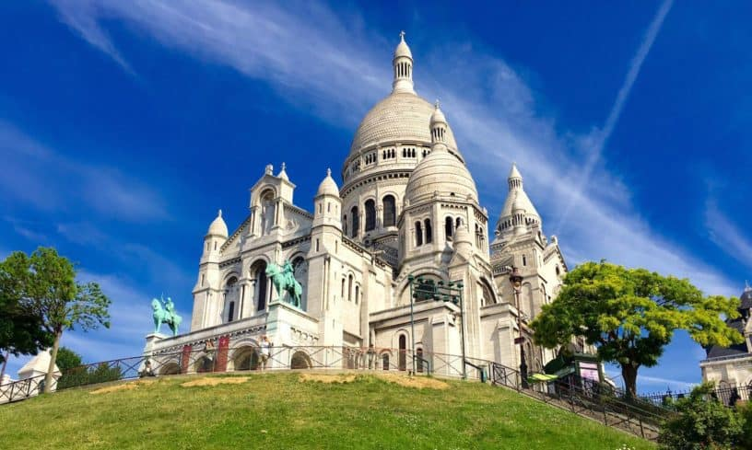
Places to visit for backpacker
Eiffel tower
Louvre museum
Palace of Versailles
Champs-Elysees
Sacre-coeur
Arc de triomphe

Slide 6
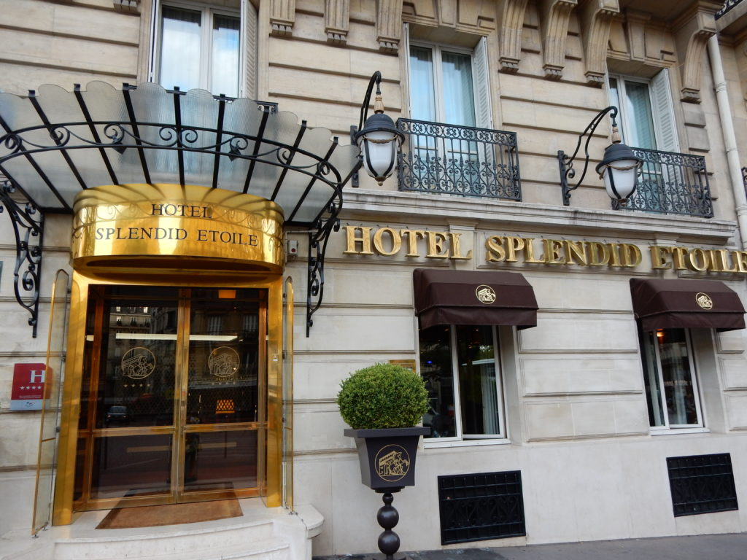
Da Vinci hotel and spa
Hôtel Splendid Etoile

Slide 7
Plan for family
Eiffel tower: 1hour and half
Disneyland Paris: 2hours and half
Champs-Elysees: 2hour
Last day in Paris
Hotel 2: Hôtel Splendid Etoile
Louvre museum: 1 hour and half
French Riviera: 2 hour
Palace of Versailles: 2hour
Last day in france

Slide 8
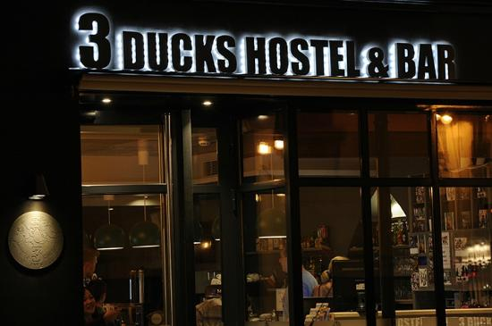
3 ducks hostel & bar

Slide 9
Transportation
You will be using a tour bus but if you wish to use a cab which we give with the package you can use the free cab driver

Slide 10
Why France?
It can be a bit costly to visit France but it is worth it you can indulge in fine French cuisine and the mesmerizing monuments and you can encounter kind and friendly locals in France. The Eiffel tower continues to be the cultural symbol of France while champs Elysees remains the heart and soul of Paris. You will feel like you are just at home when you visit France. So please do

Slide 11
THANK YOU

