Slide 1
Culture project!
By: Ema Celikovic and Kanyawee Tongla from class 8I

Slide 2
what does the Culture project entail
I have researched on Thailand through my partner, Kanyawee, whereas she has gained information my country, Bosnia.
We have both shared details of our culture with each other and expressed what it is like to be Thai/Bosnian.
We went through traditional dances, music, food, fashion and geography of the country and how people live out their daily lives.
These are my results…

Slide 3
Quick Facts about thailand
-Thailand is the only country in Asia that has not been colonized by a European country
-Thailand is known for their large rice and marvelous orchid fields.
-The population is 67 million with most residents living in the capitol, Bangkok
-Bangkok was named the most beautiful city in the world back on 2011

Slide 4
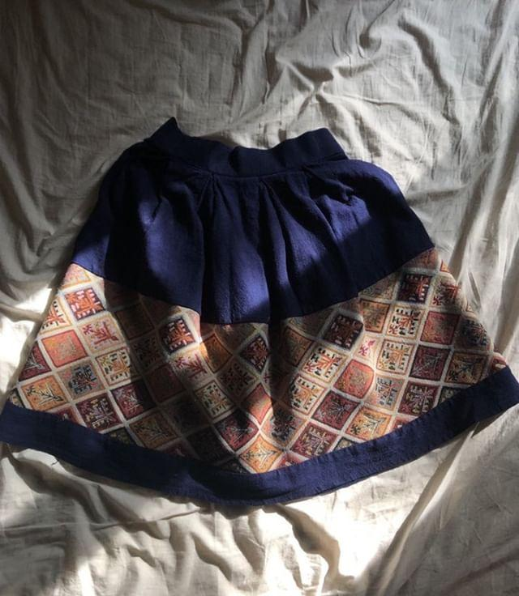
Traditional clothing
Traditional clothing in Thailand is often worn at weddings, children's day and at Songkran which is a water festival celebrated for a new year. Up until 1888, Songkrun was the official New Year in Thailand but in 1940, it was changed to January 1st.

Slide 5
Traditional Food
This is fried chicken with sticky rice and Larb which is a meat salad that is originally from Laos but Laos used to be a part of Thailand so it still counts.
The main ingredient in Larb is meat which can be any kind but most popular is Beef.
Sticky rice is a popular food consumed across Asia but is only a staple food in Thailand and Laos meaning that it is consumed by routine.

Slide 6
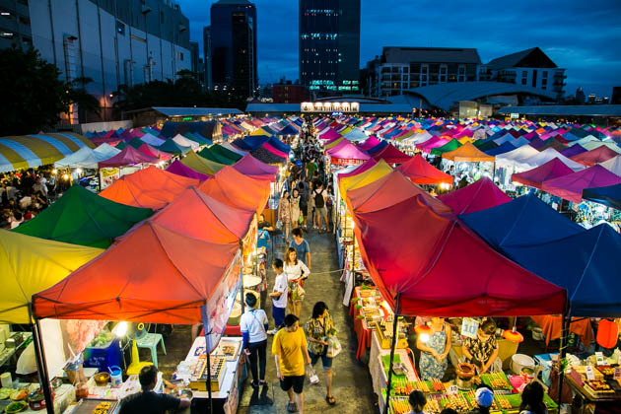
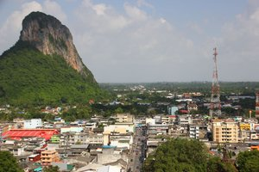
Hitting Home
Kanyawee told me stories of her home in Thailand, Phattalung which is actually her mothers home town. She told me how much she loves the crepes in Thailand and how she would get ice cream with her friends or family and go to the park.
Sometimes Kanyawee goes to the markets at night where they would sell food or different kind of merchandise

Slide 7
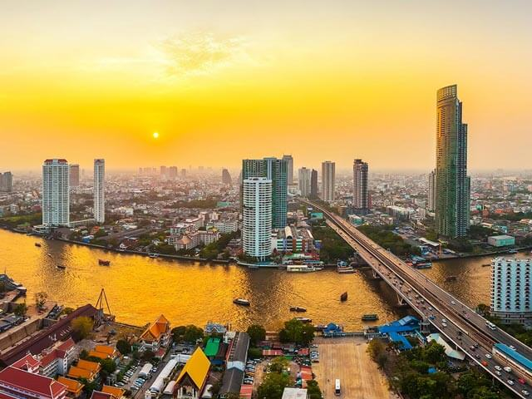
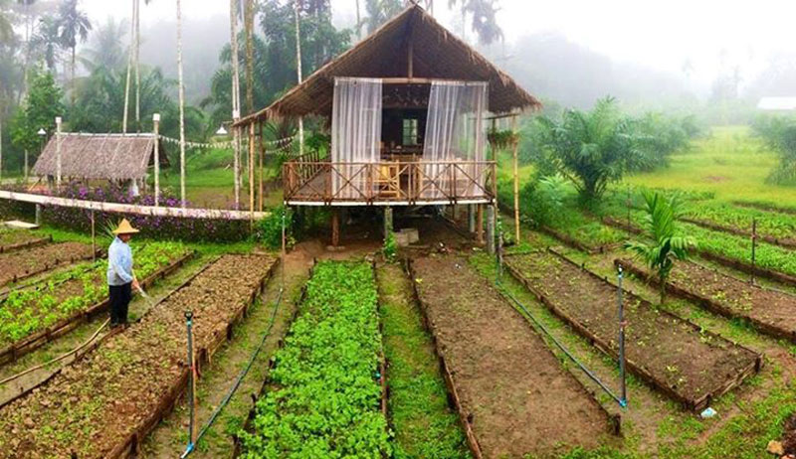
Daily life in thailand
In rural areas, most people get their earnings by selling things that they craft, grow or make at markets during the night. A lot would also be farmers.
Other parts of the country had regular jobs that you would find anywhere else in the world. Engineers, business people, etc…

Slide 8
What have I learned from this?
This research has been a lot of fun for me as I learned about a whole new culture that is completely different than mine. It certainly has taught me a lot about diversity and accepting people for who they are.
Martin Luther King, Jr once said, “An individual has not started living until he can rise above the narrow confines of his individualistic concerns to the broader concerns of all humanity.”
In the eleven years that I have been living here, of all the things that I have learned, accepting differences and tolerance are one of the most important lessons because the differences make us better people and ultimately, form a better community.

