Slide 1
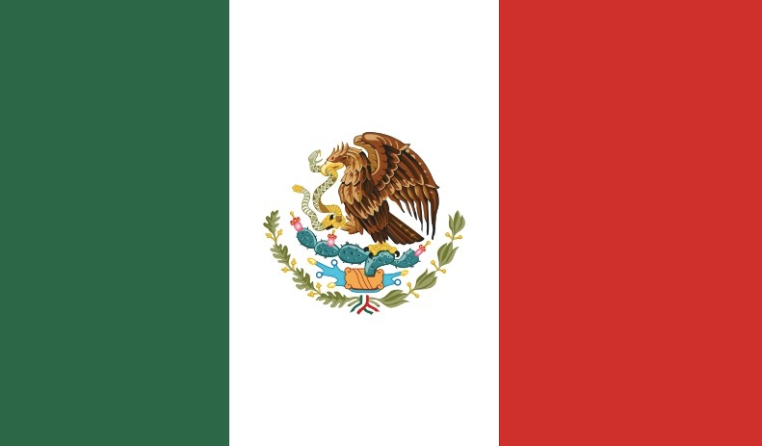
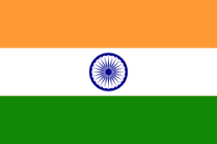
Mexican and Indian
Food and Clothing
Done by Samaira and Ananya

Slide 2
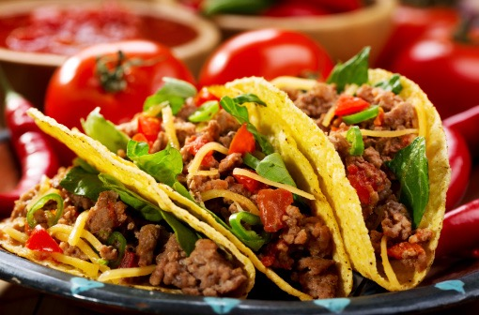
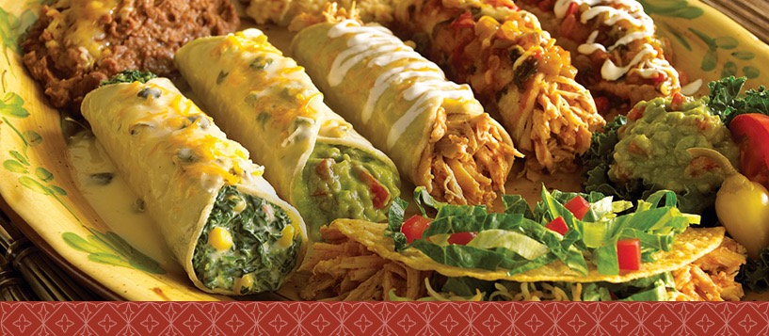
Mexican food
The history of Mexican cuisine is long and deep, pre-dating the Republic itself by centuries. Many of the foods we find in the Mexican pantry carry ancient pedigrees. Beans, tomatoes, corn, chile peppers -- they rank among the world's first cultivated foods and were staples of ancient Aztecs and Mayans.Mexican food is one of the most popular cuisines of the world, with its famous tacos, nachos or the enchiladas,However, Mexican cuisine is much more than the popular spicy salsa and the refreshing guacamole.Mexican cuisine has a wide variety of influences owing to the colonization in the earlier period, and later to the trade functions between people from various countries and colonies.
Here are some Mexican foods that have been carried on until now from previous years in history:
1.Tacos
2.Guacamole
3.Enchiladas

Slide 3
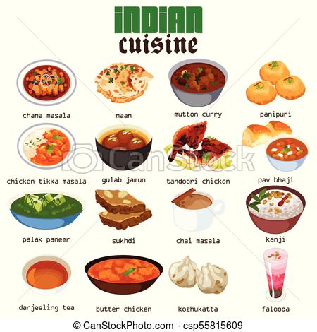
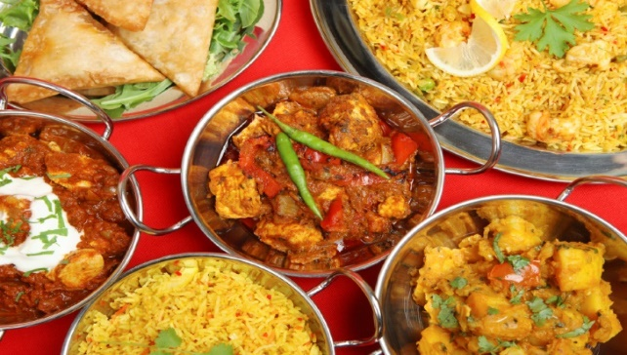
Indian food ; north and south indian cuisine
North Indian cuisine is a part of the different cuisines found in India.
You will find a variety of different food in the northern side of India, for e.g;
Dal Makhni-The primary ingredients are whole black lentil, red kidney beans, butter and cream.
Rajma Chawal- a protein rich Red Kidney Beans curry
Kadhai Paneer-Gravy is a mouthwatering recipe made from paneer cooked in a spicy gravy made of onions, tomatoes, capsicum and traditional Indian spices.
Butter Chicken-The spices may include garam masala, ginger, garlic, pepper, coriander, cumin, turmeric and chili. The chicken is usually roasted.
Chole Bhature- This Punjabi dish is a combination of chana masala (spicy white chickpeas) and bhatura, a fried bread made from maida flour (soft wheat).
Carrot Halwa- a sweet pudding made by simmering fresh grated carrots in milk
Gulab Jamun- is usually made up of powdered milk, a pinch of all-purpose flour (optional), baking powder and clarified butter (ghee)
As written in the previous slide, India has different types of southern food, for e.g;
Dosa: a home-made pan cake prepared out of fermented rice and lentil batter and served hot with condiments such as sambar and chutney. There are varied kinds of Dosas available either stuffed or plain that has garnered much fame as a South Indian delicacy.
Idli: a South Indian steamed cake made out of fermented rice and black lentils (de-husked) that is savored with condiments like sambar and chutney.
Upma: a thick porridge prepared with roasted semolina or coarse rice flour which may include different vegetables and seasonings.
Parotta: a layered flatbread prepared with Maida flour, eggs, ghee/oil and served with vegetarian or non-vegetarian curry.
Poori: unleavened deep-fried bread served with curry among others.

Slide 4
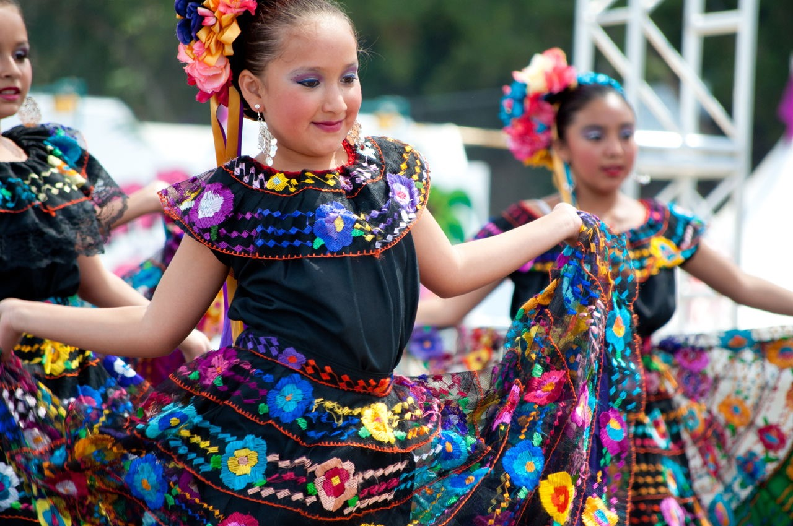
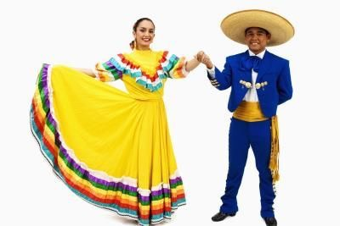
Mexican Clothing
Traditional Mexican clothing combines native and European elements. The fibers of choice across the country are cotton, bark and agave.In the past, Mexican clothing was dyed with natural components found in local plants, but as soon as aniline dyes were brought from Europe they became the first dying choice. Although Mexican clothes nowadays do not differ much from what we wear here in Europe and North America, their traditional dress is quite different. Traditional Mexican clothes were designed to keep people cool in the hot climate that can be found in the deserts to the north to the jungles in the south.The most popular and well-known women's pieces of clothing in Mexico are huipil, quechquémitl, rebozo,

Slide 5
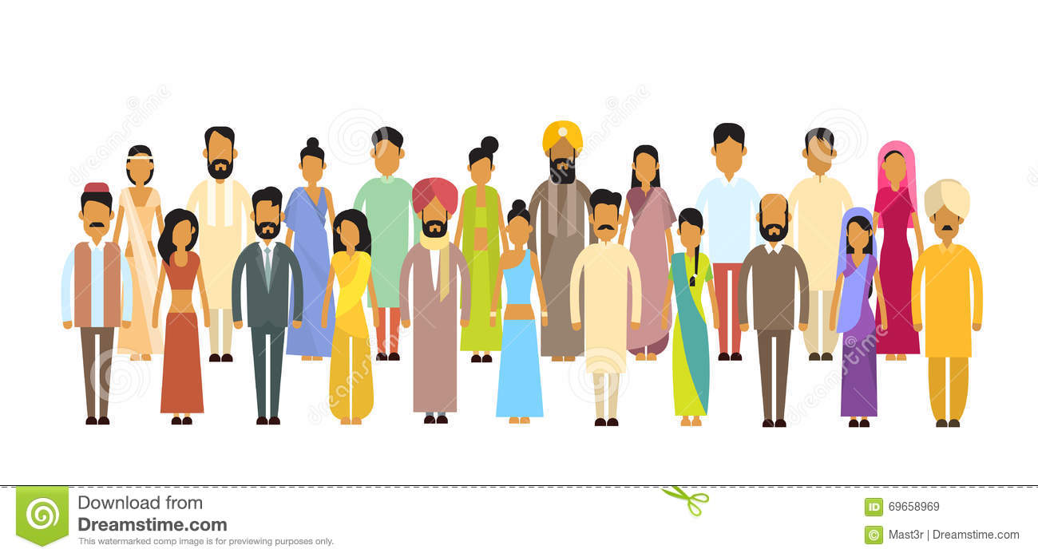
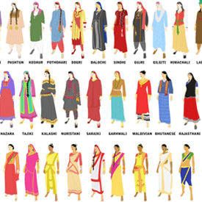
The traditional Indian clothing
Clothing in India changes depending on the different ethnicity, geography, climate, and cultural traditions of the people of each region of India.
Men-The traditional dress for Indian men essentially is Dhoti paired with Kurta and Gandhi Ttopi or Oagri. Dhoti is a six feet unstitched garment worn in a particular style which gives the pant effect rather than a skirt effect! It is paired with a stitched upper garment called Kurta which is normally longer than a shirt with two slits on each side. A Nehru topi/cap or a petah/pagri/turban accompanies depending on the culture and/or religion.
Women- Salwar Kameez is to Indian fashion what rice is to Indian food – a staple; or, it has become so over the years. The traditional salwar kameez, as the name goes, is a standard set of a top, bottom, and a dupatta

Slide 6
Thank You
Gracias | Shukriya
Hope you liked our presentation

