Slide 1
Comparing countries
winter break project

Slide 2
palestine
Palestine is an Arab country situated in western Asia, middle east.
The name/ term Palestine comes from 5BC ancient Greece when “Herodotus” had wrote of a “district of Syria” called Palestine.
Palestine has been started to be recognized as an independent state.
The neighboring countries of Palestine are Jordan, Lebanon and Egypt.

Slide 3
usa
USA is situated in North America, covering 664,709 square kilometers of water and 9,826,675 square kilometers of land! Becoming the third largest nation in the world.
America was given its name after the Italian explorer, Amerigo Vespucci.
There are a total of 50 states in the United States of America
The neighboring countries of the United States of America is Canada, Mexico and Russia.

Slide 4
china
China is situated in both northern and eastern hemispheres, it occupies 9,596,961 total square kilometers. The population of china (2017) was 1.386 billion.
The name China comes from the Sanskrit Cina, the name was obtained from the Chinese Qin.
There are 34 divisions or also thought of as 23 provinces. The biggest and most crowded city of China is Shanghai followed by Guangzhou and Beijing.
The neighboring countries are (both south and north) Korea, Japan, India and Russia.

Slide 5
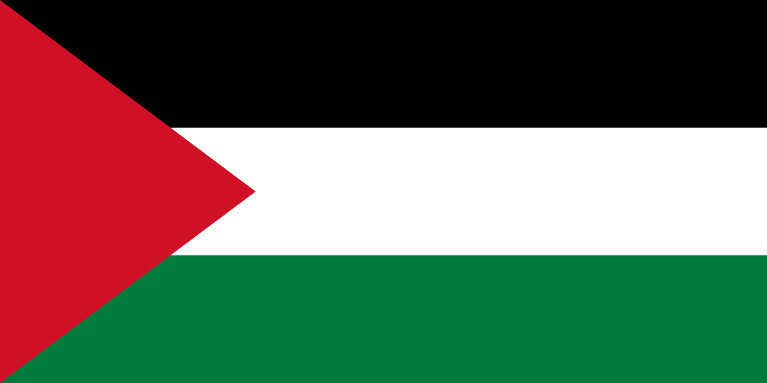
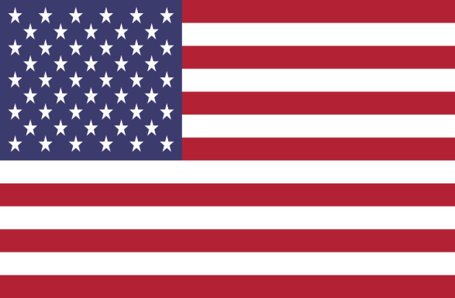
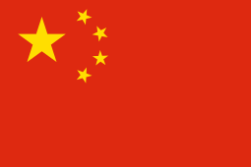
flags
Palestine
USA
US
C
China
The tri-colored (green, black, white) horizontal stripes are overlaid/covered with a red colored triangle.
The white indicates purity and innocence whilst the red shows hardiness and valor. Blue show justice, vigilance and perseverance
The red symbolizes the people as red is their color and the stars indicate communism and the social classes of people

Slide 6
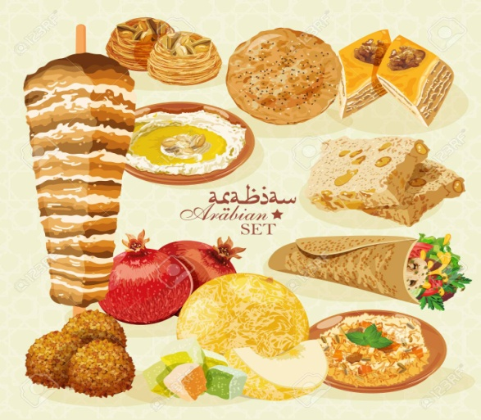
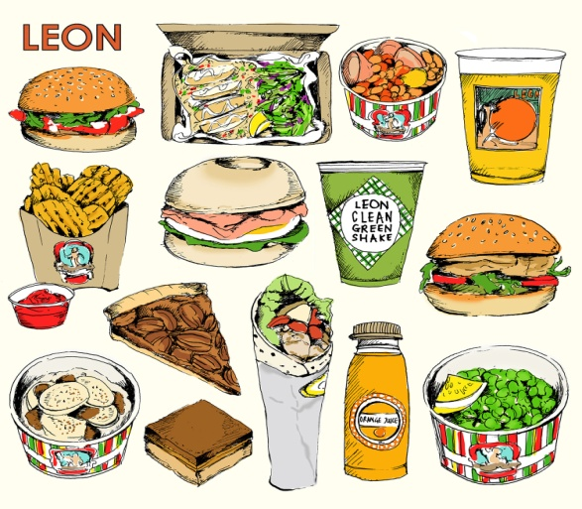
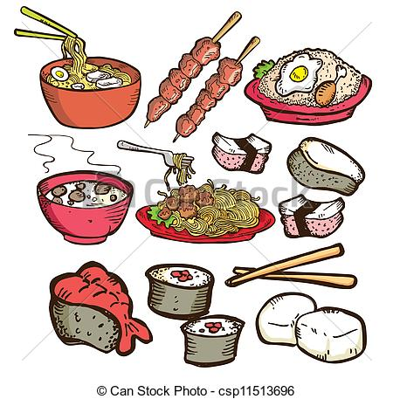
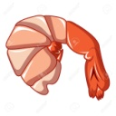
foods
Palestine
USA
China
Palestinians and most arabs enjoy eating shawerma, falafel, kunafeh, and busbousa ect. But it has to be halal/ pork free
Americans eat a variety of foods ranging from bagels, burgers and pizzas to pies, cookies and chips. there are healthy options like salads and vegan foods
Chinese and most Asians prefer the spicy and flavorful varieties of food including ramen, hotpot, sushi ect.

Slide 7
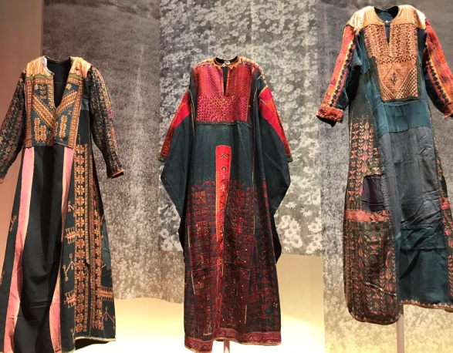
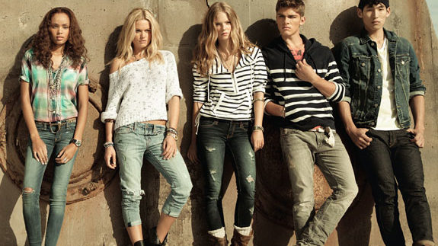
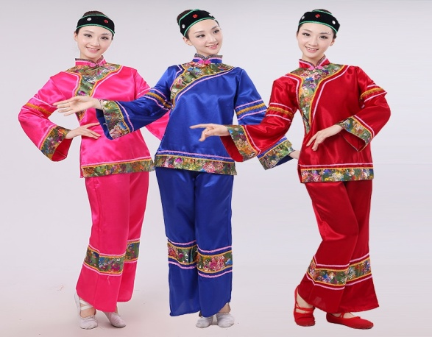
clothes
Palestine
USA
China
Clothes in palestine have to cover the knees, shoulders, “chest” part of the body and head. Most of the time people wear abaya or kandura.
They have started many trends like ripped t shirts/ jeans and are free to wear mostly anything. In the winter they have to wear thick clothes due to the climate.
Most people wear shirts and jeans but on some occasions they wear the traditional long cut, loose dresses. They aim to wear red as it symbolizes people.

Slide 8
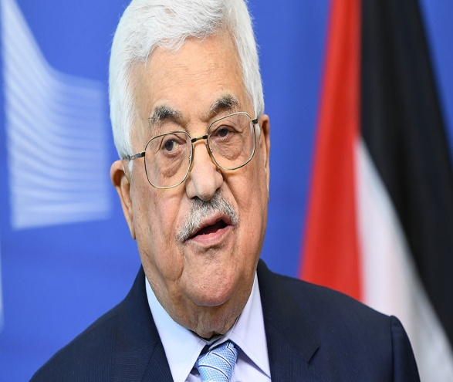
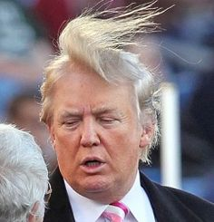
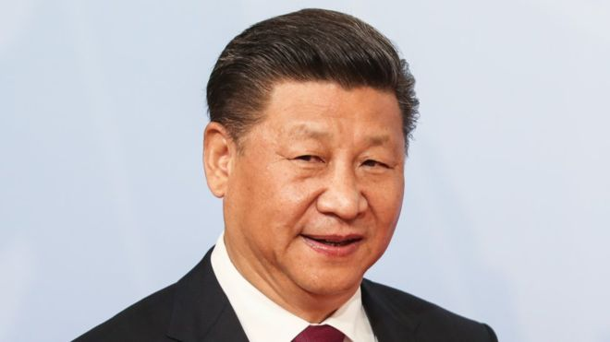
president
Palestine
USA
China
President of palestine: Mahmoud Abbas was elected on 9 January 2005 by the community/ voters of palestine.
Donald Trump was elected on November 8, 2016 running against Hillary Clinton.
Xi Jinping was elected on 15 November 2012. He would serve as president in china for ten years. (as of 2018, 4 more years)

Slide 9
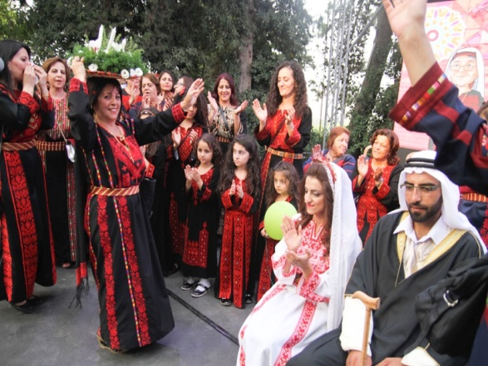
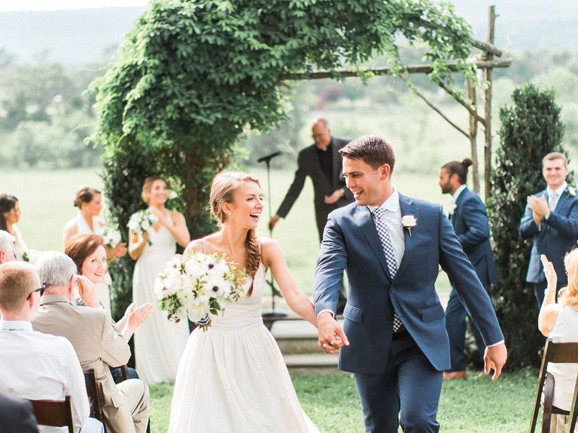
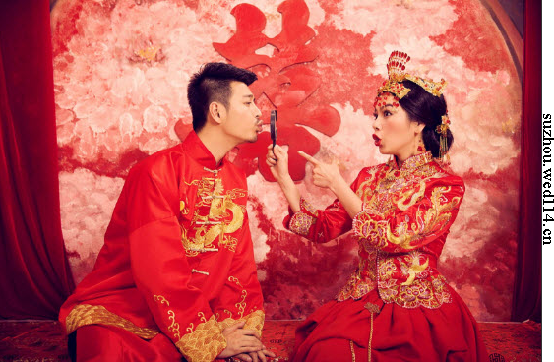
weddings
Palestine
USA
China
The traditional Palestinian wedding can last from anywhere between 2 days to one week, the day always ends with an event/ party.
The bride will walk down the aisle in
church, they speak their vows then the priest announces them husband and wife. Then she’ll dance with her father then husband
The proper and traditional Chinese way to get married is to get the perfect day set by a fortune teller, have a tea ceremony and many more occasions. They both aim to wear red.

