Slide 1
CIVIC ENGAGEMENT PROJECT ~ ENGLISH ASSIGNMENT
By :
Priya Ajay Arora
10 D

Slide 2
INTRODUCTION
PERIOD: 1 Aug 2018 to 31 Oct 2018
COMPANY: PMI Consulting FZ LLE
CLIENT: GLOBAL MANUFACTURING ORGANISATION LIMITED
Project: VAT RETURN
COMPANY DETAILS:
License no.: MC 11712
Issuing authority: Masdar free zone Abu Dhabi
Legal status: Limited Liability company incorporated in Masdar City
License segment: Association (Non- Profit Organization)
Activities: Transportation

Slide 3
About VAT in UAE
VAT is a tax on consumption. From January 1st, 2018, all companies supplying goods and services in the UAE, and the wider Gulf region, had to register for and charge VAT. In the UAE, the rate is 5%.
IMPLICATION OF VAT ON INDIVIDUALS
VAT, as a general consumption tax, will apply to the majority of transactions in goods and services. A limited number of exemptions may be granted.
As a result, the cost of living is likely to increase slightly, but this will vary depending on an individual's lifestyle and spending behavior. If an individual spends mainly on those things which are relieved from VAT, he is unlikely to see any significant increase.
The government will include rules that require businesses to be clear about how much VAT an individual is required to pay for each transaction. Based on this information, individuals can decide whether to buy something.

Slide 4
About VAT in UAE
IMPLICATION OF VAT ON BUSINESS
Businesses will be responsible for carefully documenting their business income, costs and associated VAT charges.
Registered businesses and traders will charge VAT to all of their customers at the prevailing rate and incur VAT on goods/services that they buy from suppliers. The difference between these sums is reclaimed or paid to the government.
VAT-REGISTERED BUSINESSES GENERALLY:
must charge VAT on taxable goods or services they supply
may reclaim any VAT they have paid on business-related goods or services
keep a range of business records which will allow the government to check that they have got things right.
VAT-registered businesses must report the amount of VAT they have charged and the amount of VAT they have paid to the government on a regular basis. It will be a formal submission and reporting will be done online.
If they have charged more VAT than they have paid, they have to pay the difference to the government. If they have paid more VAT than they have charged, they can reclaim the difference.

Slide 5
Methodology
I contacted PMI Consulting FZ LLE tax consultants with a view to have basic insights on VAT in UAE and how VAT returns are filed with Federal Tax authorities (FTA).
The firm was kind enough and helped me learn on the basics of VAT and how to gather information for filing the VAT returns on FTA portal.
I worked on a client Global Manufacturing Organization Ltd (GMOL) of the firm and gathered the following information from Tally accounting software.
I learnt on how to run the following reports from Tally accounting software for the period 1 Aug 2018 to 31 Oct 2018:
Output Tax report – 5% Tax charged on customers
Input Tax report – 5% Tax paid on suppliers for availing services/good bought

Slide 6
Results and findings
The results of the reports run in Tally accounting software is summarized as under:
Company has Output VAT to be paid of AED 229,687
Company has Input VAT to be claimed of AED 55,337
Net VAT to be paid is AED 174,350
VAT refund to be adjusted from Quarter 2 30.6.18 AED 60,874
VAT refund to be adjusted from Quarter 1 30.4.18 AED 5,198
Net VAT to be paid after set off AED 108,277
Please view the next slide…….

Slide 7
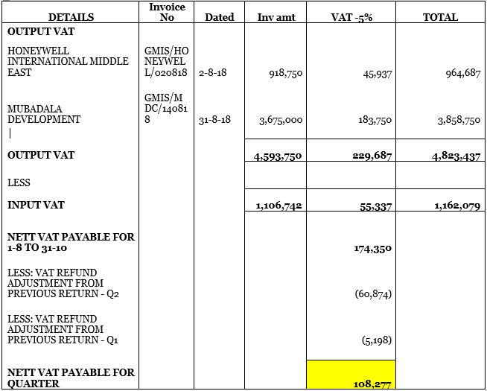

Slide 8
VAT Return Filing On FTA Website
After the above findings and results, I went to the FTA portal and logged into the client’s account. The following screen appeared showing the below-mentioned details:
Dashboard
My Profile
Downloads
My Payments
Excise Tax
Excise Goods list
VAT
My Goods List

Slide 9
VAT Return Filing On FTA Website
I used VAT tab and clicked on VAT return and started the process of inputting the numbers as per the results obtained.
In the output section, AED 4,593,750 was entered in standard rated supplies in Dubai and AED 229,687 was entered as VAT amount.
In the Input section, AED 1,106,742was entered in standard rated expenses in Dubai and AED55,337 was entered as VAT amount.
Once done, the Net VAT liability was shown as AED 174,350 and confirming all the numbers we clicked on submit button and the VAT return was filed with FTA.
Later, I went to the My Payments tab and started the payment process for VAT. The company had carried forward credits of AED 60,874 and AED 5,198 from Q2 & Q1 respectively.
These were set off with AED 174,350 and a net VAT liability was shown as AED 108,277. The company used its Master card to make the above-mentioned payment and the payment was done to FTA.

Slide 10
LEARNING EXPERIENCE
PMI consulting FZ LLE gave me a rich experience on how to file the VAT returns with FTA which will help me in future in case I choose accounting and tax as fields of specialization.
Had a brief insight of the dynamic entrepreneurial skills of professionally qualified business owners
Going forward and near future my goals are to become an Accounting and Tax specialist by pursuing Chartered Accountancy/ACCA/CPA as a professional course. Also, I want to study VAT law and tend to give tax agent examination as conducted by FTA UAE.

Slide 11
CROSSLINKING WITH ENGLISH
Report Writing and Article Writing skill was embellished.
Analytical ability developed along with critical thinking mindset.
Punctuations & High Order Vocabulary amplified.
Formal letter writing format and content learnt.
Learnt how to write a letter of appreciation & recommendation.
Summarizing information provided for concise reference.
Communicating ideas fluently amongst others through group discussion.
Learned to frame proper Sentence structure along with word choices and uses

Slide 12
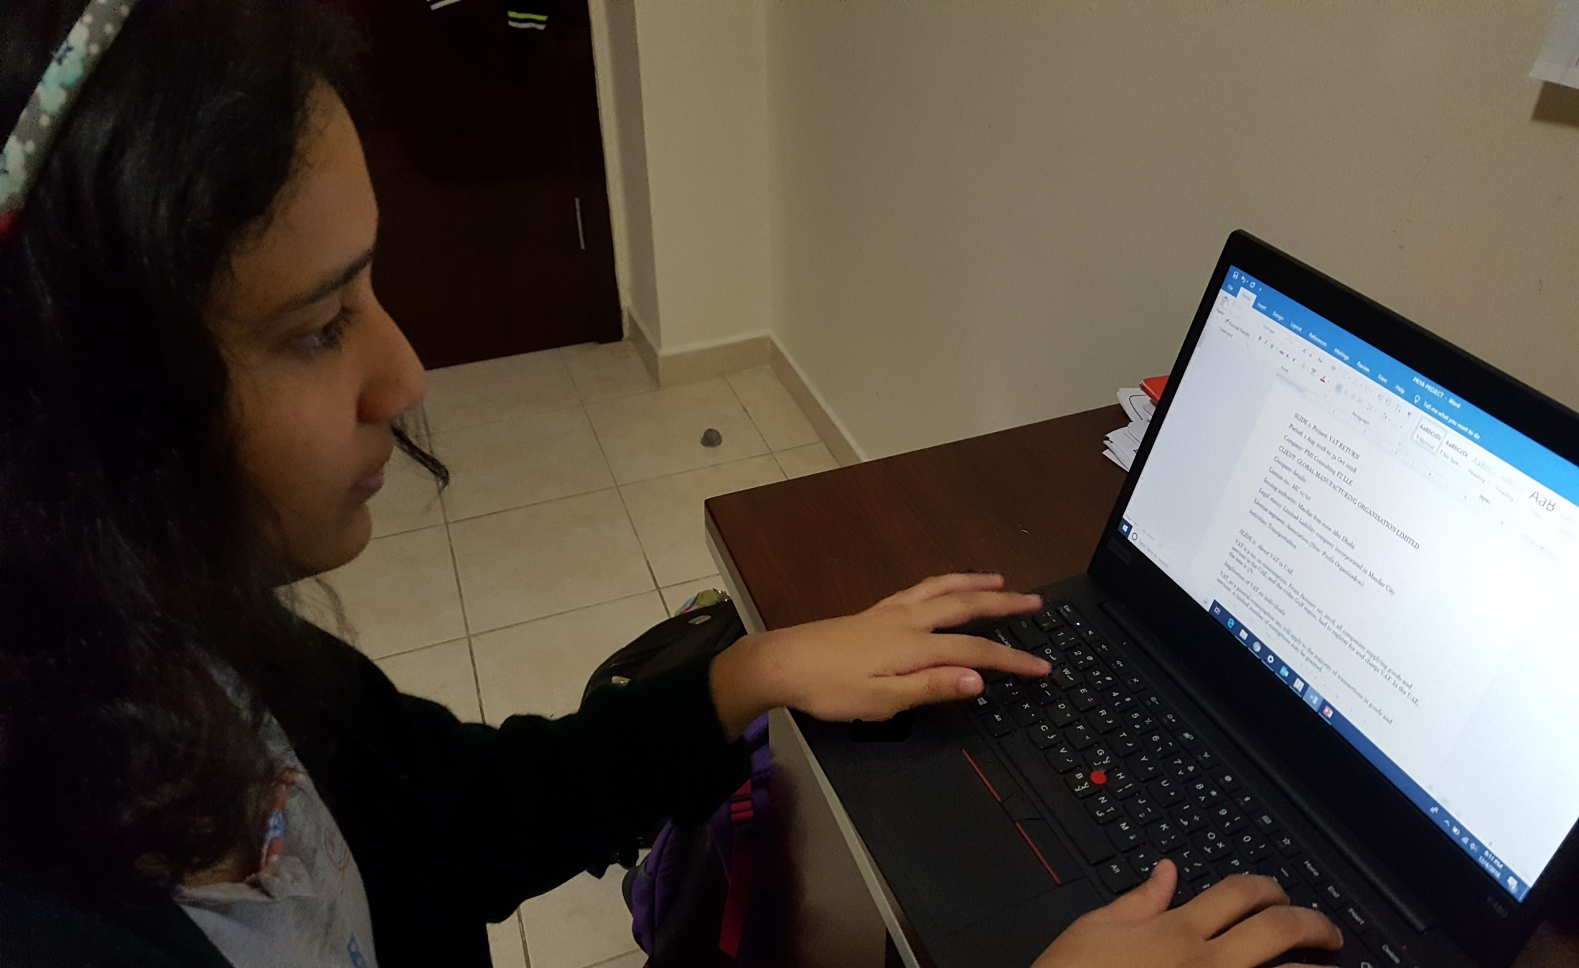
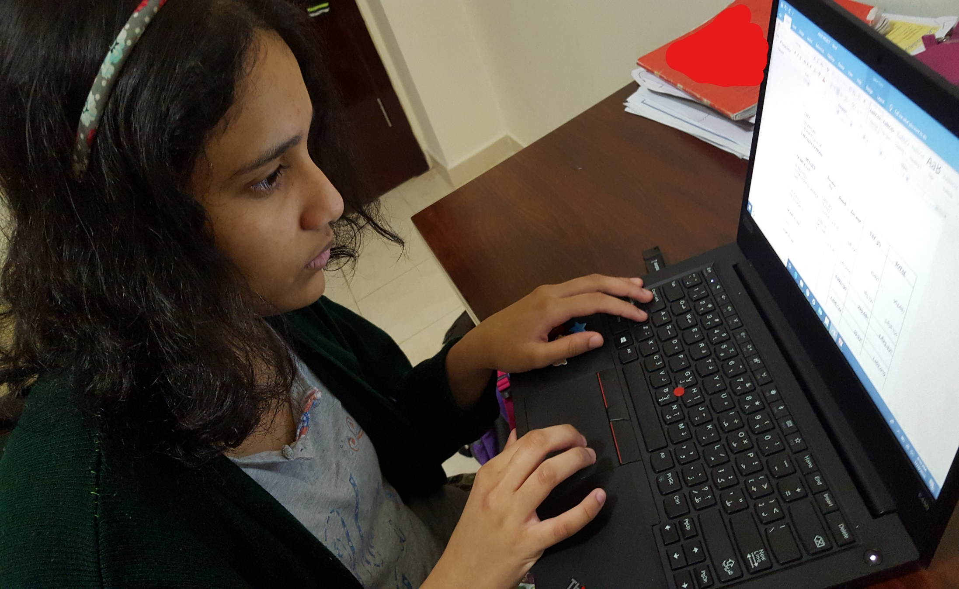

Slide 13
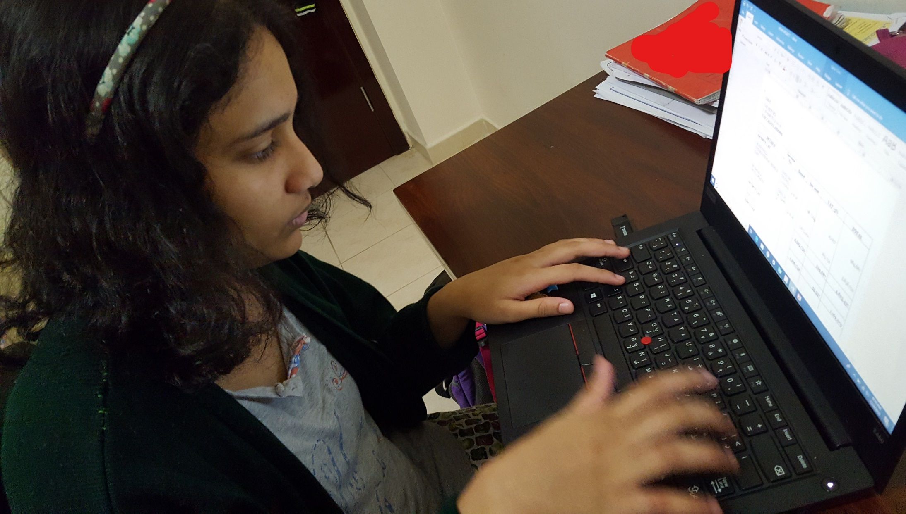
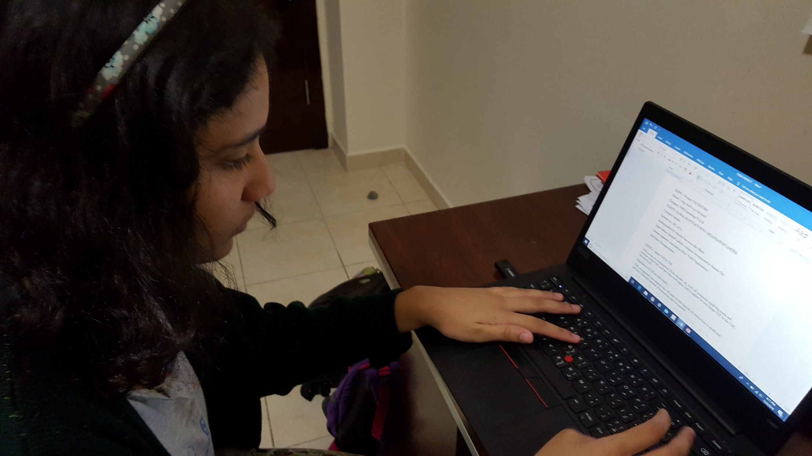
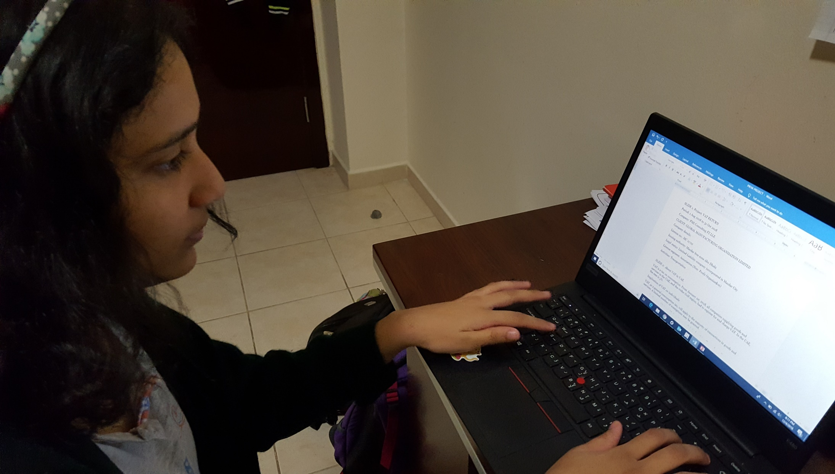
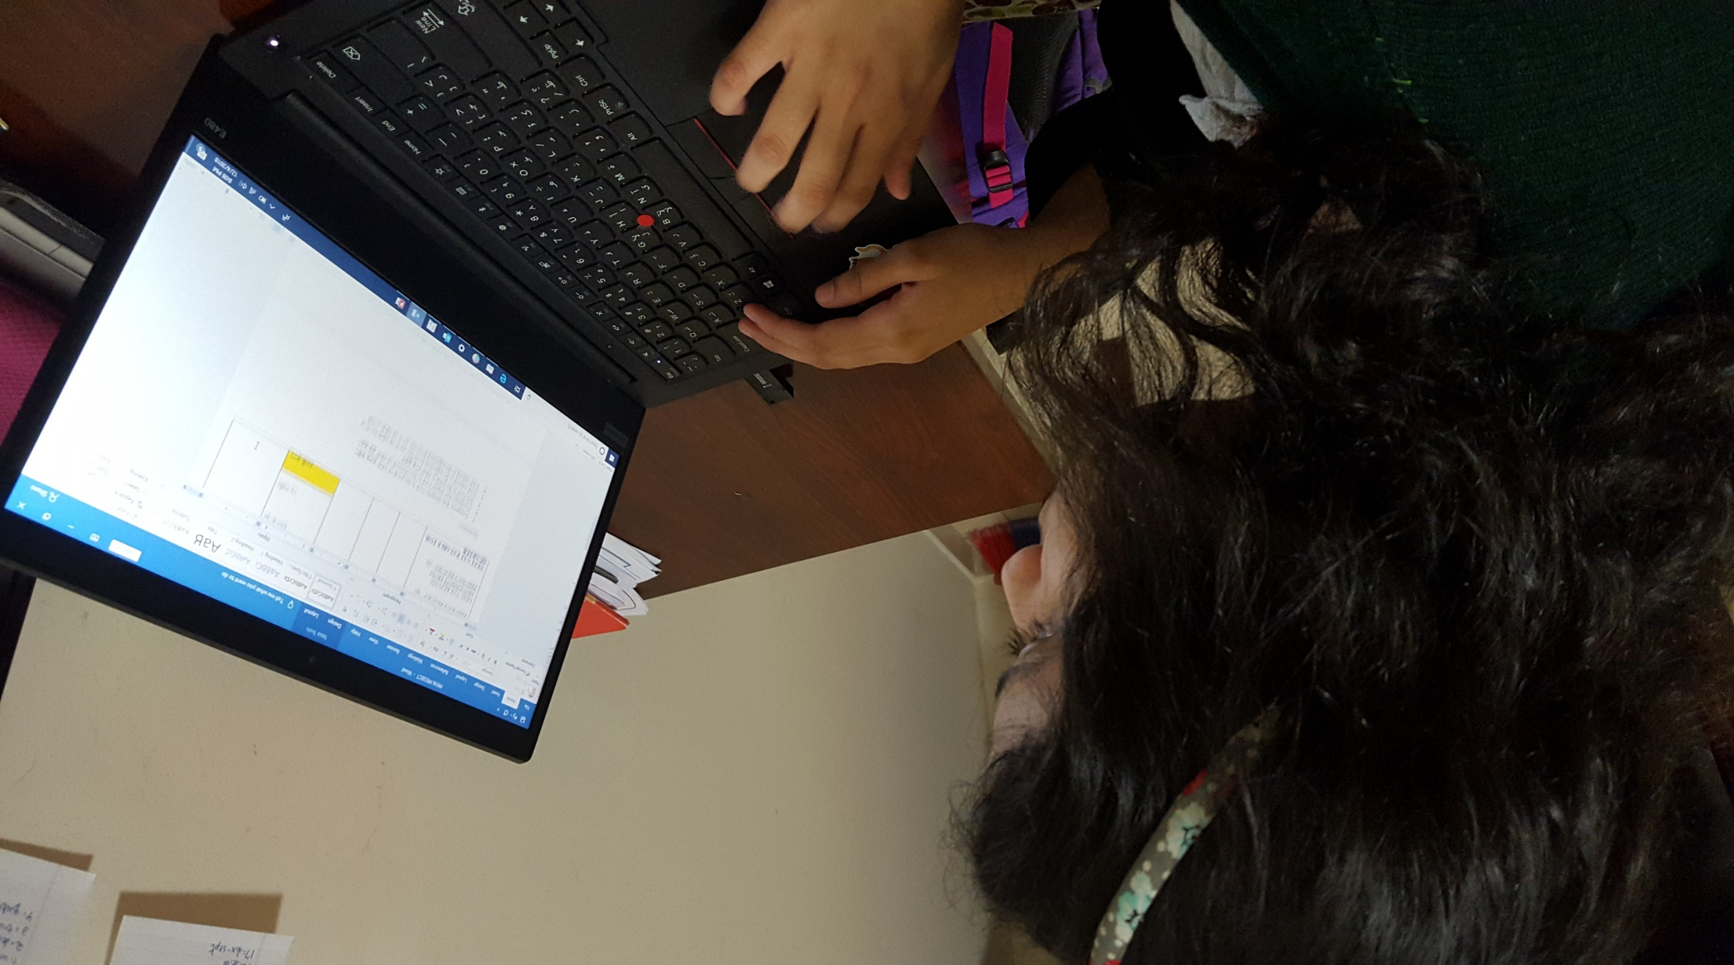

Slide 14
